Slide 1
CSE299: Junior Project Design Design & Development of AGB
Faculty Initial: ITN
Semester: Summer’19
Section: 12
Group-04
Submitted By
Anwar Shadaab (1611383042)
M Saydur Rahman (1520490642)
Kazi Sadia Kabir (1420174042)

Slide 2
List of Components
Client on Internet: Web Browser, Operating System
Web Development: HTML, CSS, Bootstrap, Jquery, Javascript, PHP
Web Server: Apache
Database: MySQL

Slide 3
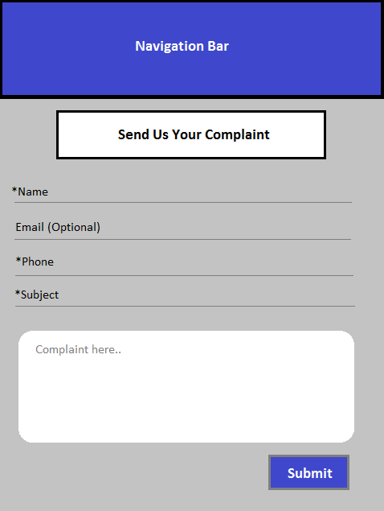
Samples

Slide 4
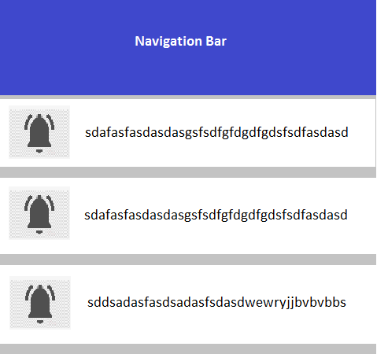
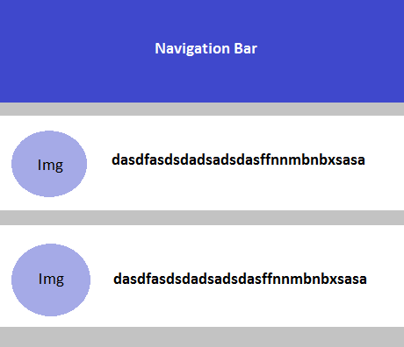
Samples

Slide 5
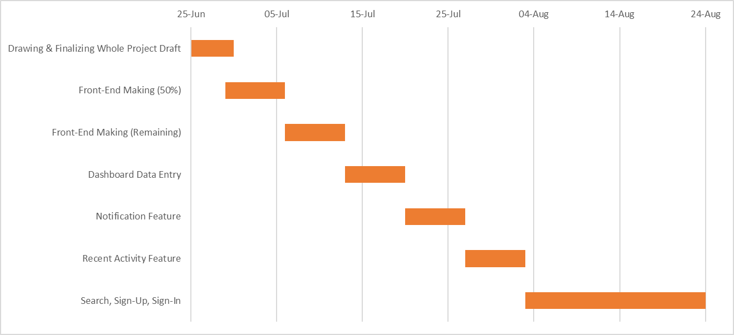
Gantt Chart

Slide 6
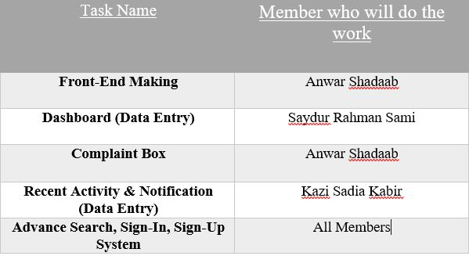
Work Distribution

